Slide 1
Unit – 6 Pointers C Programming
BSc CSIT First Semester
Mid-West University, Nepal
Prepared by:
Dabbal Singh Mahara
2023

Slide 2
Pointers
A pointer is a variable that holds address of another variable rather than actual value.
That is, a pointer is a variable that points to or references a memory location in which data is stored.
The purpose of pointer is to save memory space and achieve faster execution time.
Pointers are used frequently in C, as they have a number of useful applications.

Slide 3
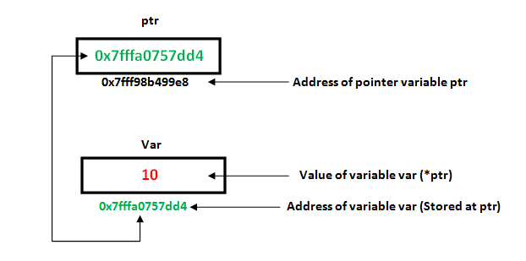
Pointer : Example
int var = 10;
int *ptr;
ptr = &var;

Slide 4
Why Pointers?
Pointers are the mechanism used in C to allow a called function to modify variables in the calling function.
Pointers provide a way to return multiple data items from a function via function arguments.
Pointers enable programs to create and manipulate dynamic data structures.
They produce compact, efficient and powerful code with high execution speed.

Slide 5
The * ( asterisk) and &(ampersand) Operators
When * is used with variable declaration before a variable's name, it becomes a pointer variable, not a normal variable. Eg. int *p;
When * is used in front of pointer variable, it indirectly references the value at that address stored in the pointer. In this case, * is also called indirection or dereference operator.
The symbol & This is called "referencing" operator.
This referencing operator is also called address operator, which gives the address of a variable, in which location the variable is resided in the memory.
Example: int x = 10;
int *p = &x;

Slide 6
Pointer Declaration and Initialization
Pointer variables like all other variables, must be declared before they may be used in a C program.
Its general form is: data_type *ptrvar;
for example: int *ptr;
This statement declares the variable ptr as a pointer to int i.e. ptr can hold address of an integer variable.
Once the pointer has been declared, it can be initialized to point to a variable using an assignment statement as follows: int a; int *x; x=&a;

Slide 7
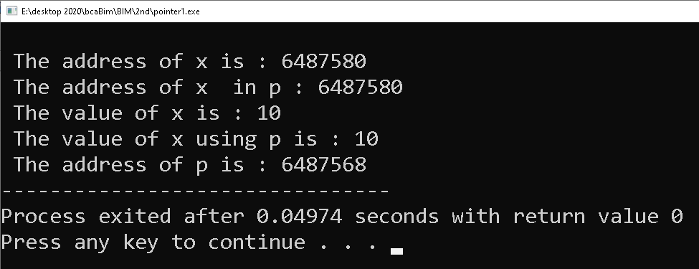
Example: Program
#include<stdio.h>
int main()
{
int x = 10;
int *p = &x;
printf("\n The address of x is : %u", &x);
printf("\n The address of x in p : %u", p);
printf("\n The value of x is : %d", x);
printf("\n The value of x using p is : %d ", *p);
printf("\n The address of p is : %u", &p);
return 0;
}

Slide 8
Pointer Arithmetic
A pointer in c is an address, which is a numeric value. Therefore, you can perform arithmetic operations on a pointer just as you can on a numeric value.
There are four arithmetic operators that can be used on pointers: ++, --, +, and –
Integer data can be added to or subtracted from the pointer variables.

Slide 9
Incrementing and Decrementing a pointer
If we increment a pointer by 1, the pointer will start pointing to the immediate next location. This is somewhat different from the general arithmetic since the value of the pointer will get increased by the size of the data type to which the pointer is pointing.
Like increment, we can decrement a pointer variable. If we decrement a pointer, it will start pointing to the previous location.

Slide 10
Example: Pointer Arithmetic
#include<stdio.h>
int main(){
int number=50;
int *p;//pointer to int
p=&number;//stores the address of number variable
printf("Address of p variable is %u \n",p);
p=p+1;
printf("After increment: Address of p variable is %u \n",p); // in our case, p will get incremented by 4 bytes.
p=p-1;
printf("After decrement: Address of p variable is %u \n",p); // P will now point to the immidiate previous location.
p=p+3; //adding 3 to pointer variable
printf("After adding 3: Address of p variable is %u \n",p);
p=p-3; //subtracting 3 from pointer variable
printf("After subtracting 3: Address of p variable is %u \n",p);
return 0;
}

Slide 11
Pointers and Array
An array name by itself is an address, or pointer.
A pointer variable can take different addresses as values.
In contrast, an array name is an address, or pointer, that is fixed. That is, array name is a constant pointer. It cannot be assigned any value.
In case of one dimensional array, an array name is a pointer to the first element in the array.
Therefore, it X is a 1D array, then then X is the address of X[0].
Moreover, the address of second array element can be expressed as (X+1) or &X[1].

Slide 12
Pointers and Array
In general, the address of of array element X[i] can expressed as either &X[i] or as (X+i).
Thus, we have two ways to write the address of any array element: either we can write the actual array element preceded by an ampersand; or we can write an expression in which the subscript is added to the array name.
So, X[i] and *(X+i) both represent the contents of the ith element of X.
In case of 2D array: int X[4][5]
*(p+i) gives the address of ith row, to access columns add column number to *(p+i).
(*(x+i) +j ) : It gives the memory address of an element in 2D(i.e. jth element in ith row)
*(*(x+i)+j) : It gives the value stored in the cell i,j

Slide 13
Pointers and 1D Array
// To read n numbers and find average
#include<stdio.h>
#include<conio.h>
#define size 100
int main()
{
float a[size], sum=0, avg=0;
int n,i;
printf("\n How many numbers?\t");
scanf("%d",&n);
printf("\n Enter numbers:\n");
for(i=0;i<n;i++)
{
scanf("%f", (a+i));
}
printf("\n The array elements are:\n");
for(i=0;i<n;i++)
{
printf("%.1f\t", *(a+i));
sum = sum +*(a+i);
}
avg=sum/n;
printf("\n Sum =%f\t",sum);
printf("\n Average = %f",avg);
getch();
return 0;
} //end of main

Slide 14
Pointers and 2D Array
//To add two matrices and print the result in matrix form
#include<stdio.h>
#include<conio.h>
#define ROW 2
#define COL 2
int main()
{
int a[ROW][COL], b[ROW][COL], i,j, m[ROW][COL];
printf("\n Enter the elements of first matrix?\n");
for(i=0;i<ROW;i++)
for(j=0;j<COL;j++) scanf("%d",(*(a+i)+j));
printf("\n Enter numbers:\n");
for(i=0;i<ROW;i++)
for(j=0;j<COL;j++)
scanf("%d",(*(b+i)+j));
for(i=0;i<ROW;i++)
{
for(j=0;j<COL;j++)
*(*(sum+i)+j)= *(*(a+i)+j)+*(*(b+i)+j);
}
printf("\n The sum of the matrices:\n");
for(i=0;i<ROW;i++)
{
for(j=0;j<COL;j++)
{
printf("%d\t",*(*(sum+i)+j));
}
printf("\n");
}
getch();
return 0;
}

Slide 15
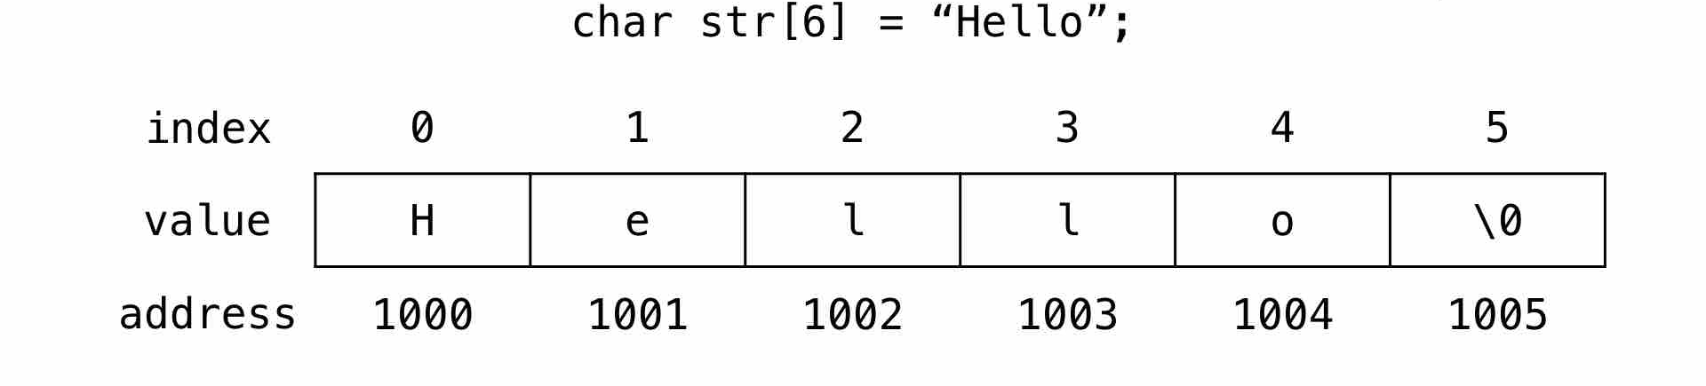
Pointers and Character Strings
The above string can be represented in memory as follows.
A string is a sequence of characters which we save in an array. And in C programming language the \0 null character marks the end of a string.
Following example shows creating a string str using char character array of size 6.
char str[6] = "Hello";
The memory representation of this string is as follows:

Slide 16
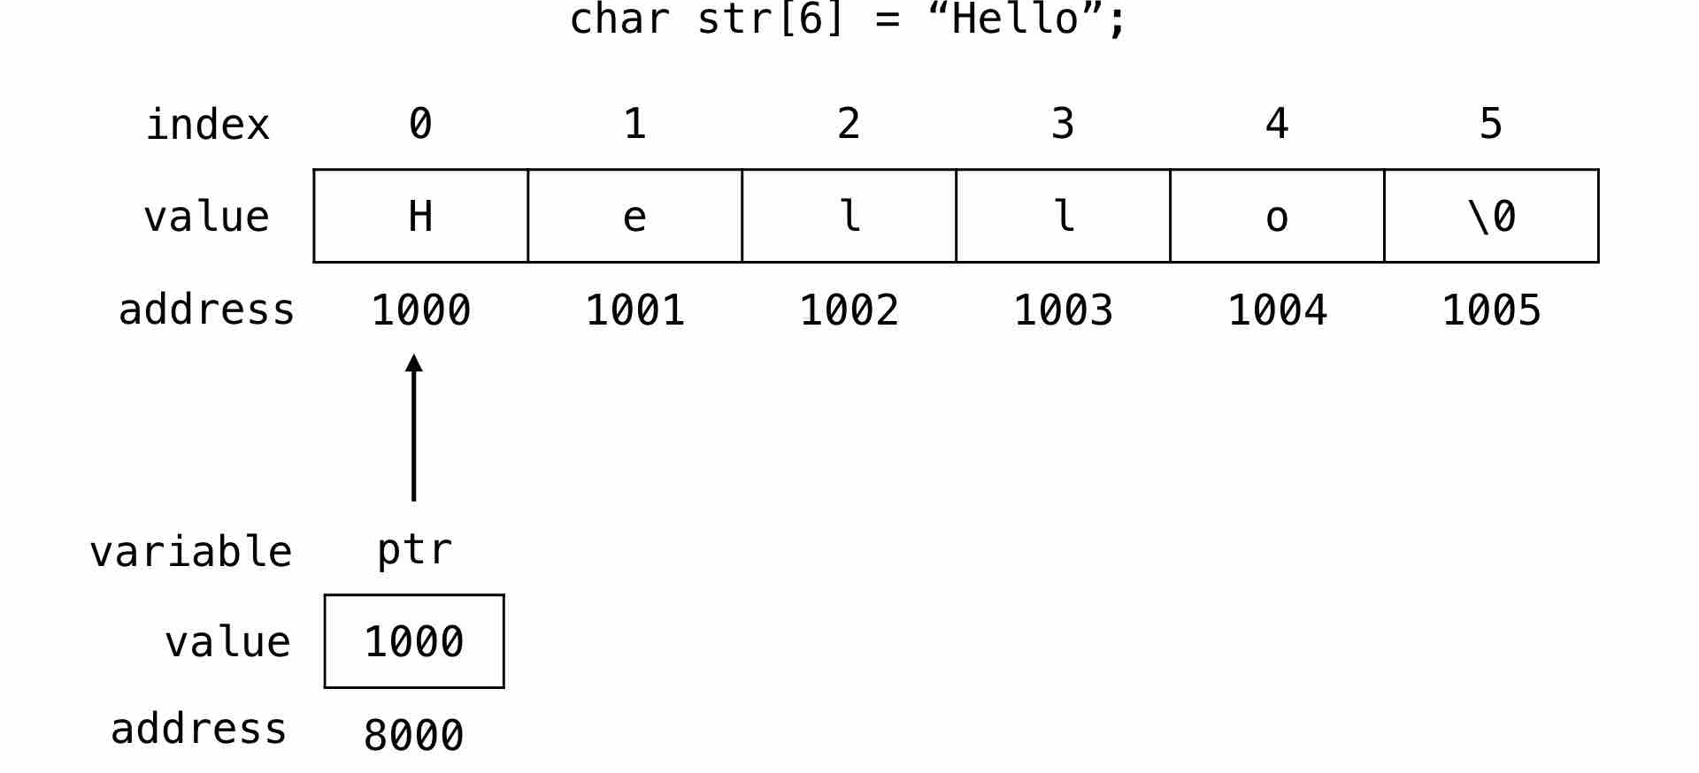
Creating a pointer for the string
The variable name of the string str holds the address of the first element of the array i.e., it points at the starting memory address.
Here, we create a character pointer ptr and store the address of the string str variable in it. ptr will point at the string str.
char *ptr = str;

Slide 17
Accessing string via pointer
To access and print the elements of the string we can use a loop and check for the \0 null character.
#include <stdio.h>
int main(void) {
// string variable
char str[6] = "Hello";
// pointer variable
char *ptr = str;
// print the string
while(*ptr != '\0') {
printf("%c", *ptr);
// move the ptr pointer to the next memory location
ptr++;
}
return 0;
}

Slide 18
Array of Pointers
An array of pointers is an array in which each cell holds addresses of some data item.
Following is the declaration of an array of pointers to an integer −
int *ptr[MAX];
It declares ptr as an array of MAX integer pointers. Thus, each element in ptr, holds a pointer to an int value.

Slide 19
Example: Array of Pointers
#include <stdio.h>
#define MAX 3
int main () {
int var[] = {10, 100, 200};
int i, *ptr[MAX];
for ( i = 0; i < MAX; i++) {
ptr[i] = &var[i]; /* assign the address of integer. */
}
for ( i = 0; i < MAX; i++) {
printf("Value of var[%d] = %d\n", i, *ptr[i] );
}
return 0;
}

Slide 20
Pointer as Argument
Pointer as a function parameter is used to hold addresses of arguments passed during function call. This is also known as call by reference.
When a function is called by reference any change made to the reference variable will affect the original variable.

Slide 21
Pointer as Argument
#include <stdio.h>
void swap(int *a, int *b);
int main()
{
int m = 10, n = 20;
printf("m = %d\n", m);
printf("n = %d\n\n", n);
swap(&m, &n); //passing address of m and n to the swap function
printf("After Swapping:\n\n");
printf("m = %d\n", m);
printf("n = %d", n);
return 0;
}
/*
pointer 'a' and 'b' holds and
points to the address of 'm' and 'n'
*/
void swap(int *a, int *b)
{
int temp;
temp = *a;
*a = *b;
*b = temp;
}

Slide 22
Pointer as Argument : Example 2
#include<stdio.h>
void cubebyRef(int *);
int main()
{
int n=5;
printf("\n Original value of n = %d",n);
cubebyRef(&n);
printf("\nCube = %d",n);
return 0;
}
void cubebyRef( int *nptr)
{
*nptr = (*nptr) * (*nptr)* ( *nptr);
}

Slide 23
Functions returning Pointer variables
A function can also return a pointer to the calling function.
In this case you must be careful, because local variables of function doesn't live outside the function.
They have scope only inside the function. Hence if you return a pointer connected to a local variable, that pointer will be pointing to nothing when the function ends.
So, it is not recommended to return the address of a local variable outside the function as it goes out of scope after function returns.
Static Variables have a property of preserving their value even after they are out of their scope. So to execute the concept of returning a pointer from function in C you must define the local variable as a static variable.

Slide 24
Example: Function Returning pointer
#include <stdio.h>
int* larger(int*, int*);
int main()
{
int a = 15;
int b = 20;
int *p;
p = larger(&a, &b);
printf("%d is larger",*p);
return 0;
}
int* larger(int *x, int *y)
{
if(*x > *y)
return x;
else
return y;
}

Slide 25
C program to illustrate the concept of returning pointer from a function
// main function
int main()
{
// Declare a pointer
int* p;
// Function call
p = fun();
printf("%p\n", p);
printf("%d\n", *p);
return 0;
}
#include <stdio.h>
// Function returning pointer
int* fun()
{
int A = 10;
return (&A);
}
Note: The function fun() returns pointer to local variable. So, will not print value of A. It will show some garbage value.

Slide 26
C program to illustrate the concept of returning pointer from a function
// main function
int main()
{
// Declare a pointer
int* p;
// Function call
p = fun();
printf("%p\n", p);
printf("%d\n", *p);
return 0;
}
#include <stdio.h>
// Function returning pointer
int* fun()
{
static int A = 10;
return (&A);
}
Note: The function fun() returns pointer to local variable. But it is static variable. So, will print value of A as 10.

Slide 27
Dynamic Memory Allocation
Creating and maintaining dynamic data structures requires dynamic memory allocation.
Dynamic memory allocation is the ability of program to obtain more memory space at execution time to hold new nodes and release space no longer needed.
The array is static data structure. That is, we must know the size of array in advance while writing the programs.
Therefore, use of array may not result the efficient utilization of memory. Sometimes it may be overestimated and sometimes it may be underestimated.
Dynamic memory allocation refers to allocating and freeing memory at execution time or run time.
To make efficient use of memory Dynamic Memory Allocation is helpful.

Slide 28
Dynamic Memory Allocation
There are four library functions malloc(), calloc(), free() and realloc() for memory management.
These files are defined within header file stdlib.h.
malloc():
It allocates requested size of bytes and returns a pointer to the first byte of the allocated block.
It's syntax is: ptr = (data type *) malloc(size_of_block); here ptr is pointer of type data_type.
Eg: x = ( int *) malloc(100*sizeof(int));
Here, a memory space equivalent to 100 times the size of an integer ( 100*2=200 bytes) is reserved and address of first byte of of this memory block is assigned to the pointer x.

Slide 29
Dynamic Memory Allocation
calloc(): Unlike malloc() the function calloc() accepts two arguments: no_of_blocks and size_of_each_block.
It allocates multiple blocks of memory each of same size and then sets all bytes to zero.
syntax: ptr = (data_type *)calloc(no_of_blocks,size_of_block);
eg. x= (int*)calloc(10, sizeof(int));
free(): It frees previously allocated space by calloc or malloc or realloc function.
The memory dynamically allocated is not returned to the system until the programmer returns the memory explicitly.
Syntax: free(ptr);
ptr is the pointer to a memory block which has already been created by allocation functions.

Slide 30
Dynamic Memory Allocation
realloc(): This function is used to modify the size of previously allocated space.
syntax: ptr = realloc( ptr, newsize);
The first argument ptr is a pointer to a block of memory for which the size is to be altered.
The second argument newsize specifies the new size of the block.
The size may be increased or decreased.
if newsize is greater than old size and if sufficient space is not available subsequent to the old region, the function realloc() creates a new region and all the old data are moved to the new region.

Slide 31
Dynamic Memory Allocation to 1 D Array
We may allocate the space for the the single dimensional array at the run time using the functions malloc() or calloc() and pointer.
The following code segment allocates the space for the size n, where n must be a constant and return the pointer for the block of memory:
int *ptr;
ptr = (int*) malloc(n*sizeof(int));
free(ptr);

Slide 32
Dynamic Memory Allocation: 1D Array
#include<stdlib.h>
#include<stdio.h> #include<conio.h>
int main()
{
int n,i;
float *p, sum=0,avg;
printf("\n How many numbers?\t");
scanf("%d",&n);
p = ( float *) malloc(n*sizeof(float));
printf("\n Enter the numbers:\n");
for(i=0;i<n;i++)
{
scanf("%f",(p+i));
sum+= *(p+i);
}
avg = sum/n;
printf("\n The sum = %.2f", sum);
printf("\n The Average = %2.f", avg);
free(p);
getch();
return 0;
}

Slide 33
Thank You!

